Slide 1
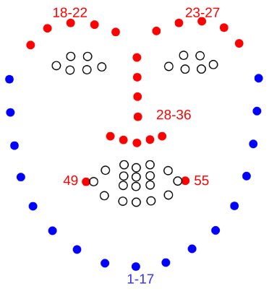
Feature
Feature/Random Variable/Variable/Attribute
Facial Features

Slide 2
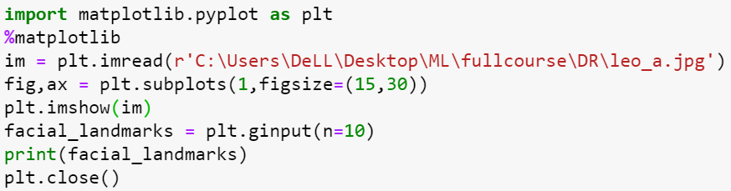
Let’s Mark Facial Features
Python

Slide 3
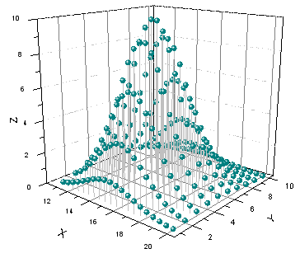
Feature Space

Slide 4
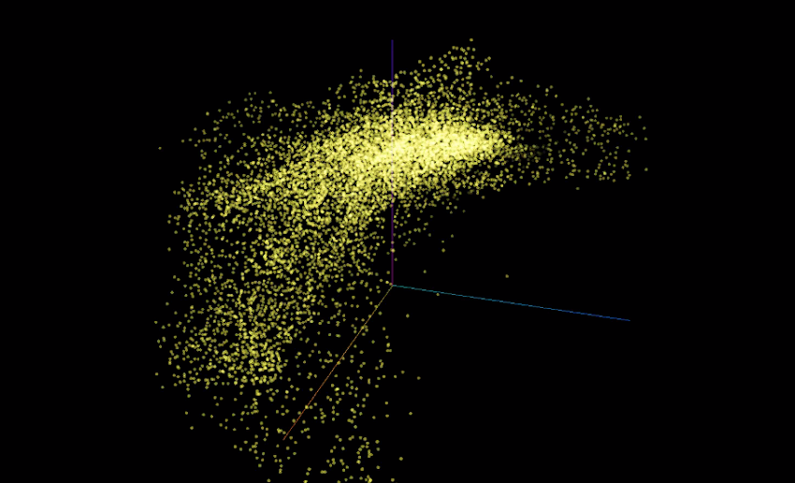
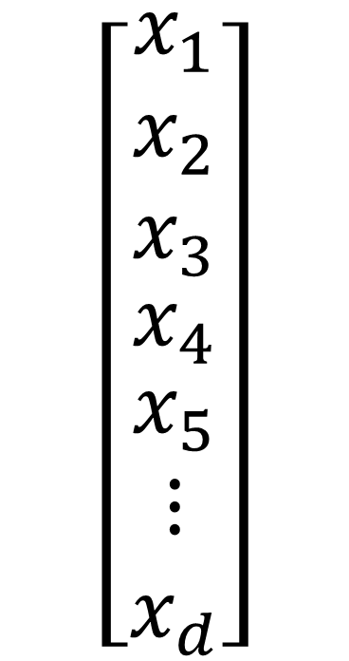
Dimensionality
$$\left[\begin{matrix}\begin{aligned}x_{1} \\ x_{2} \\ x_{3}\end{aligned} \\ x_{4} \\ \begin{matrix}x_{5} \\ ⋮ \\ x_{d}\end{matrix}\end{matrix}\right]$$

Slide 5
Activity - 1
Explore dimensionality of different data sets at archive.ics.uci.edu/ml/index.php
Deepfakes (03-11-2020)
ImageNet

Slide 6
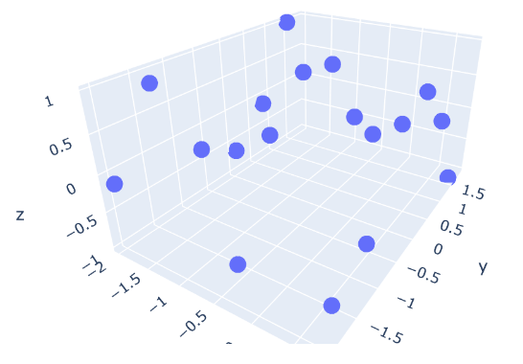
Why Dimensionality Reduction?

Slide 7
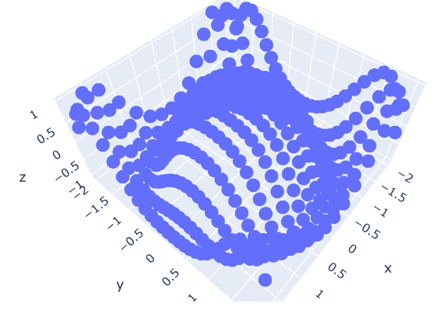
Why Dimensionality Reduction?

Slide 8
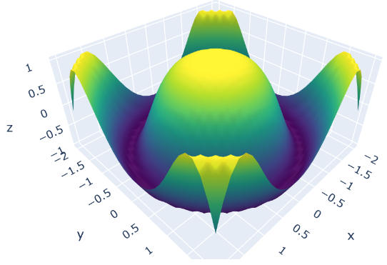
Why Dimensionality Reduction?

Slide 9
Activity - 2
What is overfitting?
How overfitting is related to dimensionality reduction?

Slide 10
Feature Selection Feature Extraction

Slide 11
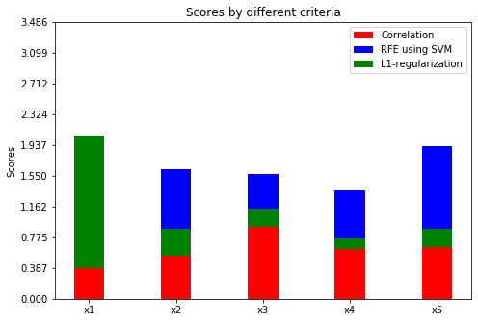
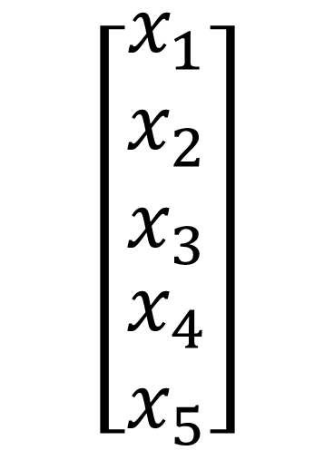
Feature Selection
$$\left[\begin{matrix}\begin{aligned}x_{1} \\ x_{2} \\ x_{3}\end{aligned} \\ x_{4} \\ x_{5}\end{matrix}\right]$$

Slide 12
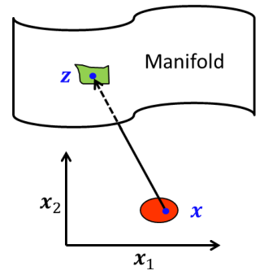
Feature Extraction

Slide 13
Feature Selection

Slide 14
Why Feature Selection?
Improved Model Performance

Slide 15
Why Feature Selection?
Improved Model Performance
Model Interpretation

Slide 16
Why Feature Selection?
Improved Model Performance
Model Interpretation
Improving Data Acquisition Process

Slide 17
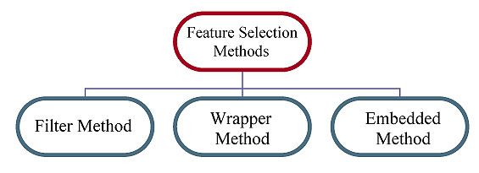
Feature Selection Methods
Evaluation Criteria
Search Strategy

Slide 18
Filter Methods
Generate Feature subset
Evaluate Subset Using Some Criteria
Best Subset

Slide 19
Wrapper Methods
Generate Feature subset
Evaluate Subset Using Some ML-Model
Best Subset

Slide 20
Embedded Methods
Train ML-Model Once
Best Subset

Slide 21
Search Strategy
Solution Space O(2^{d})

Slide 22
Search Strategy
Solution Space O(2^{d})
Forward Selection

Slide 23
Search Strategy
Solution Space O(2^{d})
Forward Selection
Backward Elimination

Slide 24
Search Strategy
Solution Space O(2^{d})
Forward Selection
Backward Elimination
Genetic Algorithms

Slide 25
Activity - 3
Why we cannot try all the subsets in wrapper methods?
What does “greedy search” mean?
Explore Simulated Annealing

Slide 26
Filter Criteria
Generate Feature subset
Evaluate Subset Using Some Criteria
Best Subset

Slide 27
Filter: Statistical based Methods
Low Variance
T-Score (binary classification)
Chi-Square Score
Cannot Handle Feature Redundancy

Slide 28
Filter: Information Theoretical Methods
Information Gain (Correlation with class label)
Minimum Redundancy Maximum Relevance(MRMR)
Conditional Information Feature Selection(CIFS)
Cannot Handle Unsupervised Scenario
Cannot Handle continuous data

Slide 29
Filter: Similarity Based Methods
Preserve Data Similarity
Similarity based on labels (Supervised)
Similarity based on distance metric (Unsupervised)
Affinity Matrix (pairwise similarity matrix)

Slide 30
Similarity Based Methods
Laplacian Score (Unsupervised)
SPEC(Supervised + Unsupervised)
Fisher Score(Supervised)
ReleifF(Supervised)
Most Cannot Handle Feature Redundancy

Slide 31
Feature Selection Python

Slide 32
Activity - 4
Is there a method for forward selection in sklearn?

Slide 33
Mathematical Foundation

Slide 34
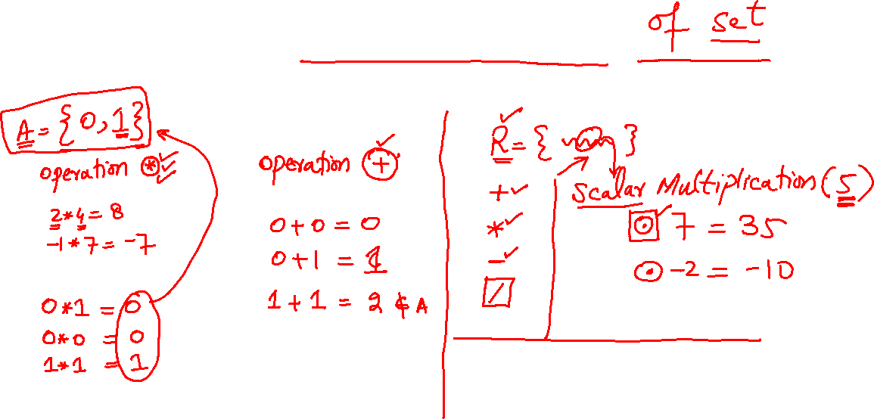
Closure

Slide 35
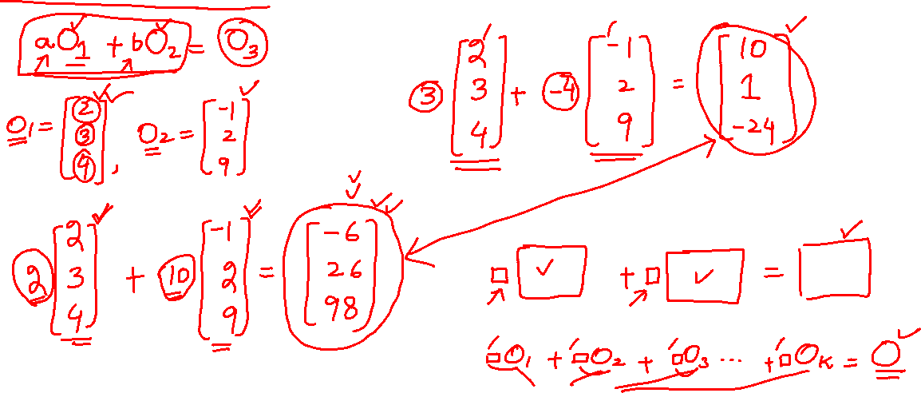
Linear Combination

Slide 36
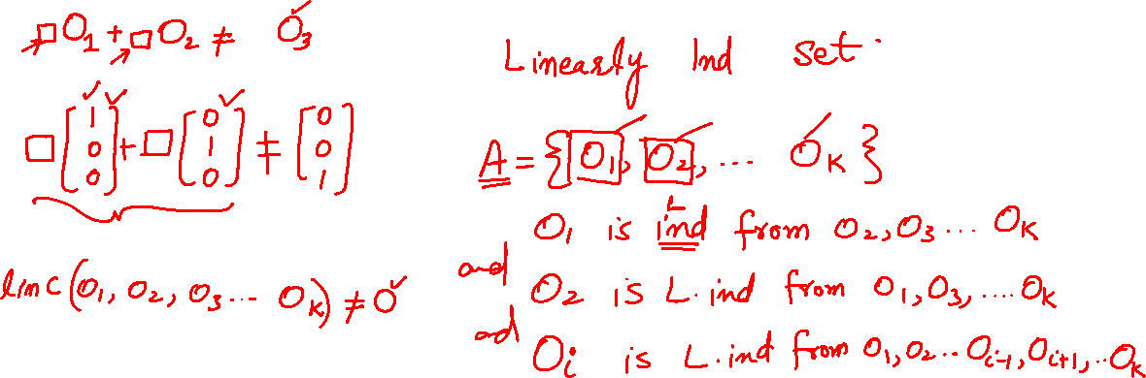
Linear Independence

Slide 37
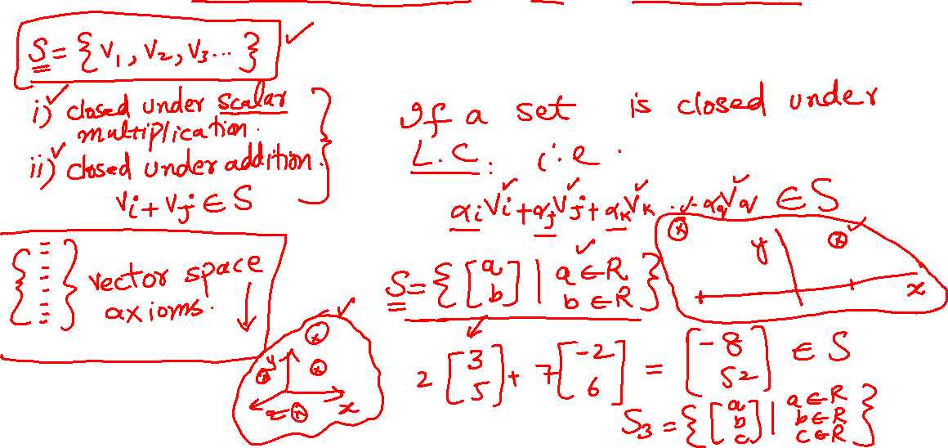
Vector Space

Slide 38
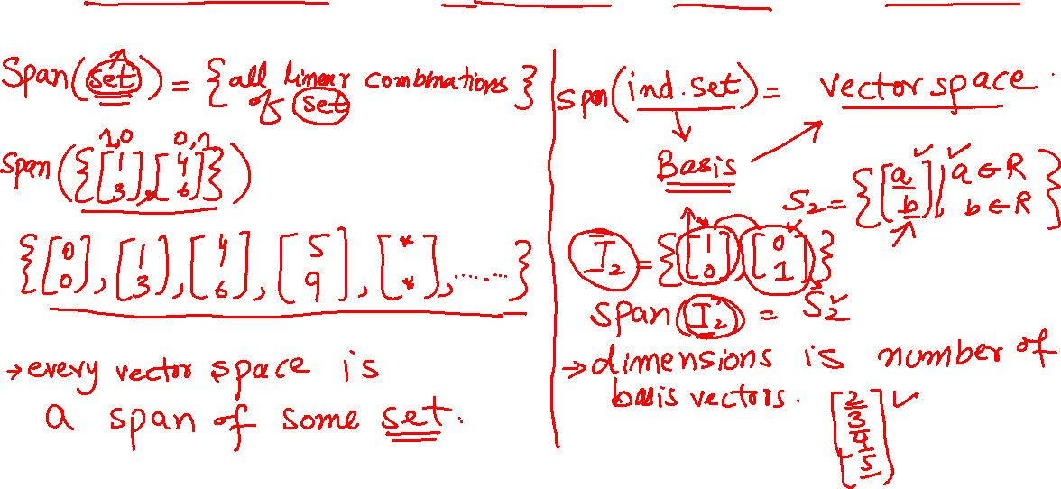
Basis, Dimensions

Slide 39
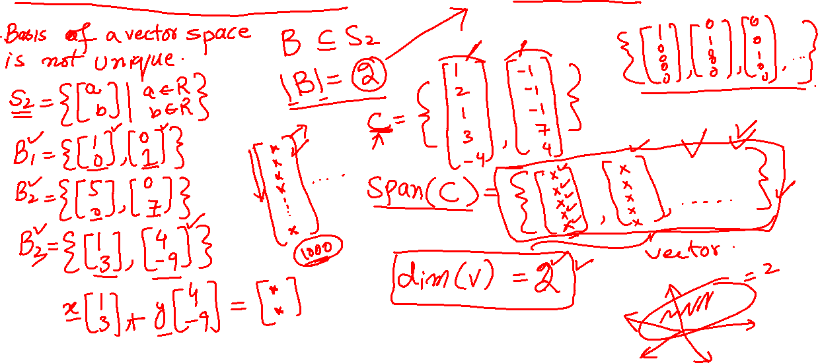
Coordinates vs Dimensions

Slide 40
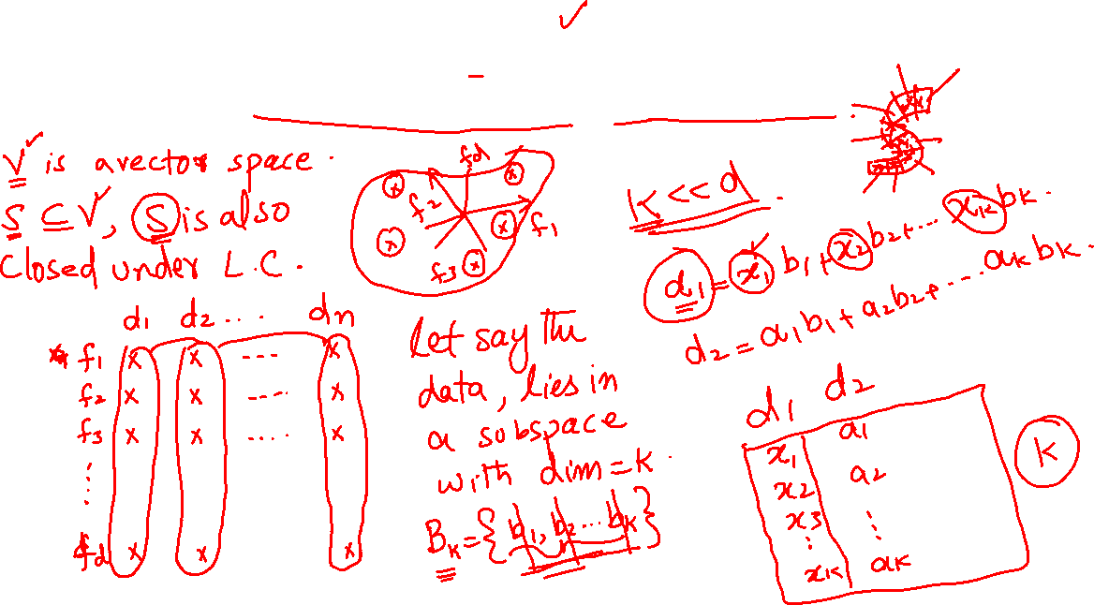
Sub Space

Slide 41
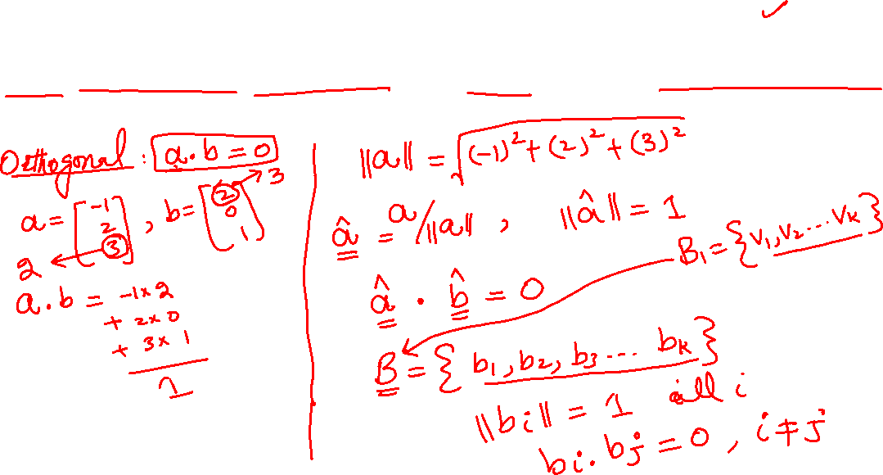
Orthonormal Basis

Slide 42
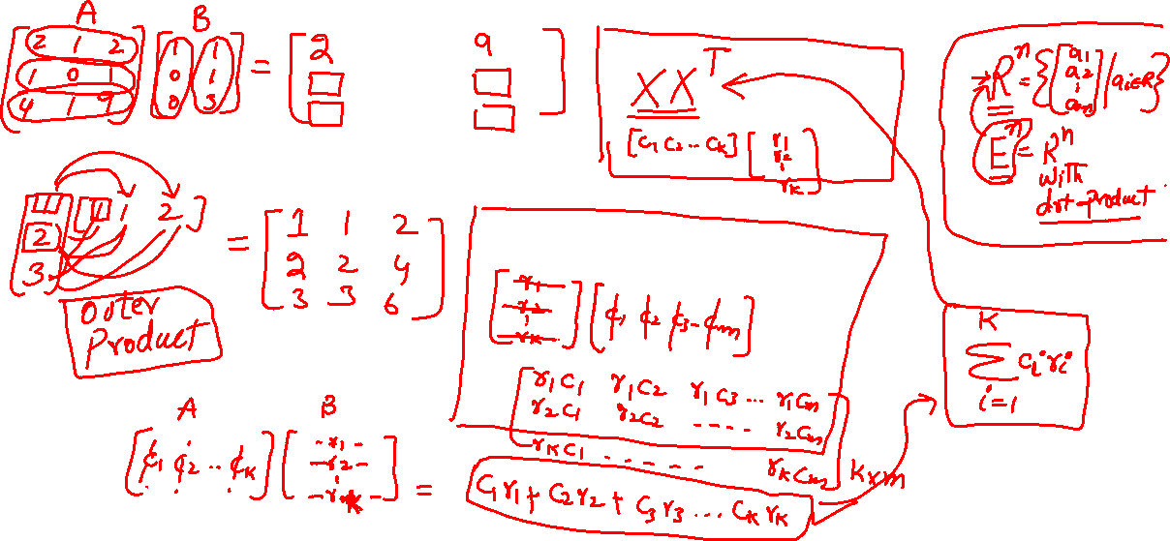
Matrix Product

Slide 43
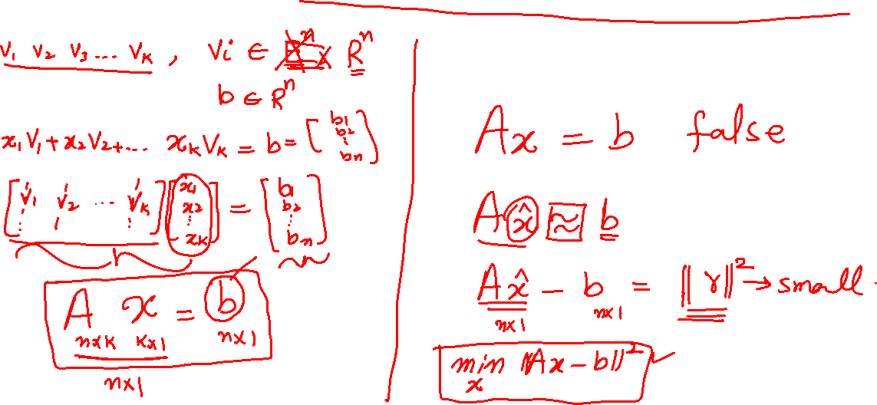
Linear Least Square

Slide 44
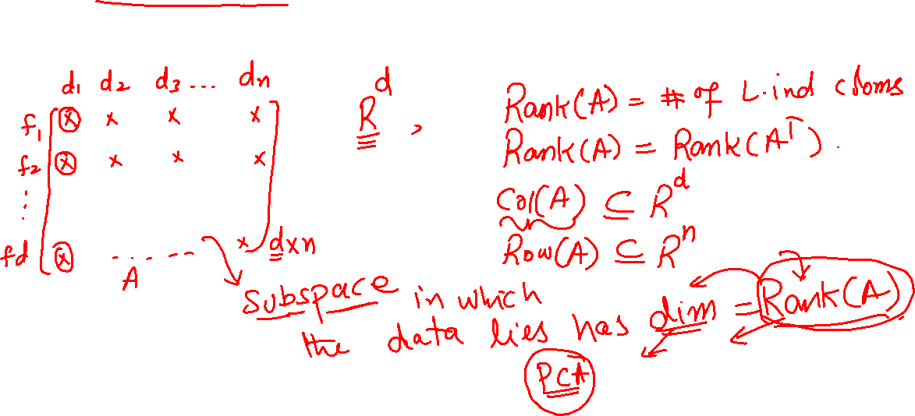
Rank of a matrix

Slide 45
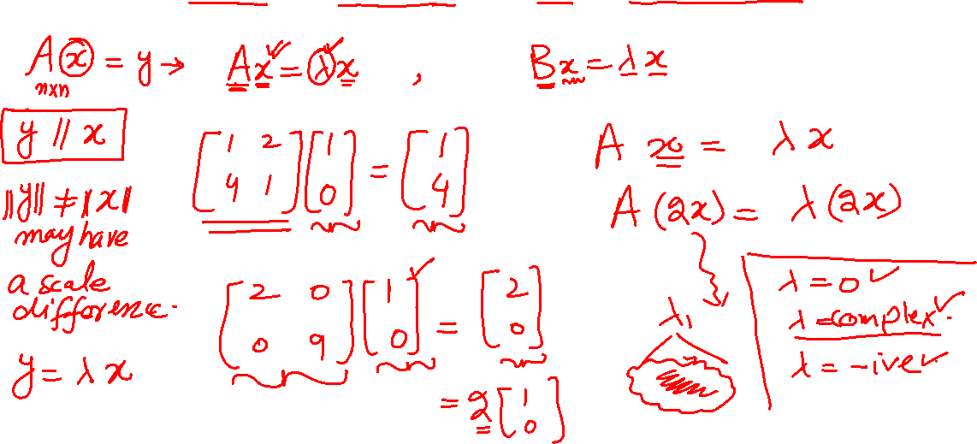
Eigen Space

Slide 46
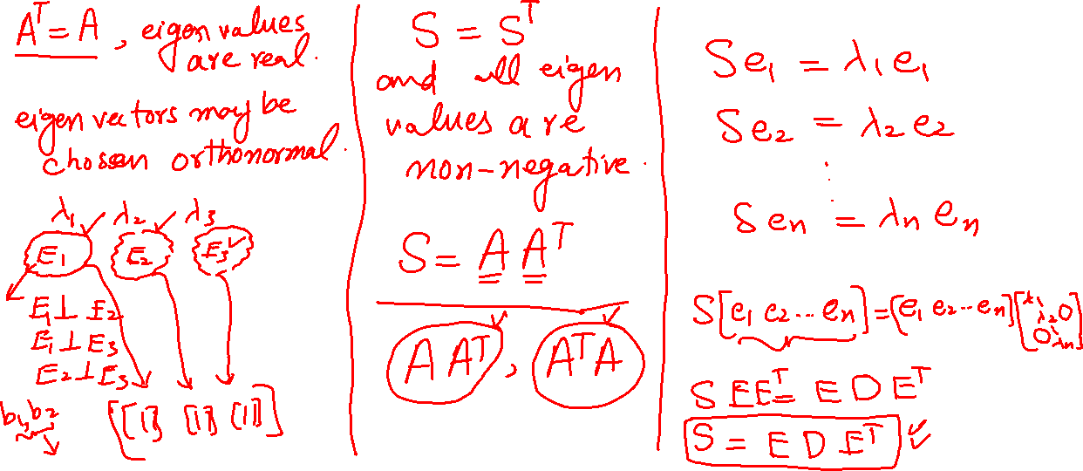
Positive Semi definite Matrix

Slide 47
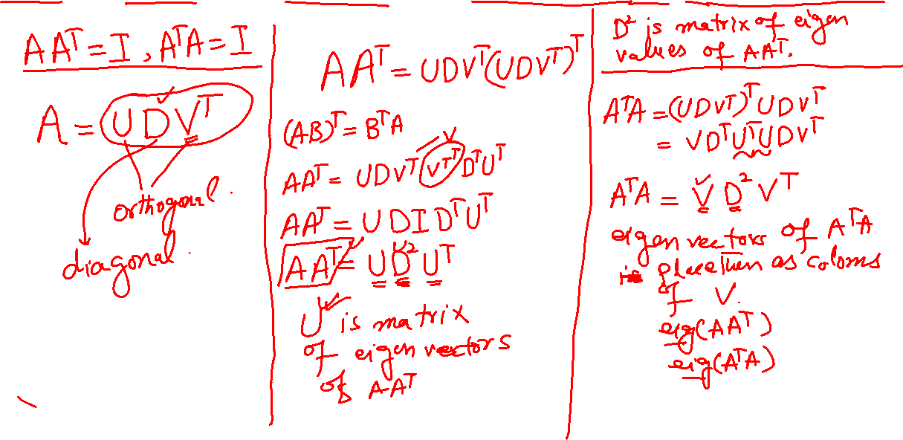
Singular Value Decomposition

Slide 48
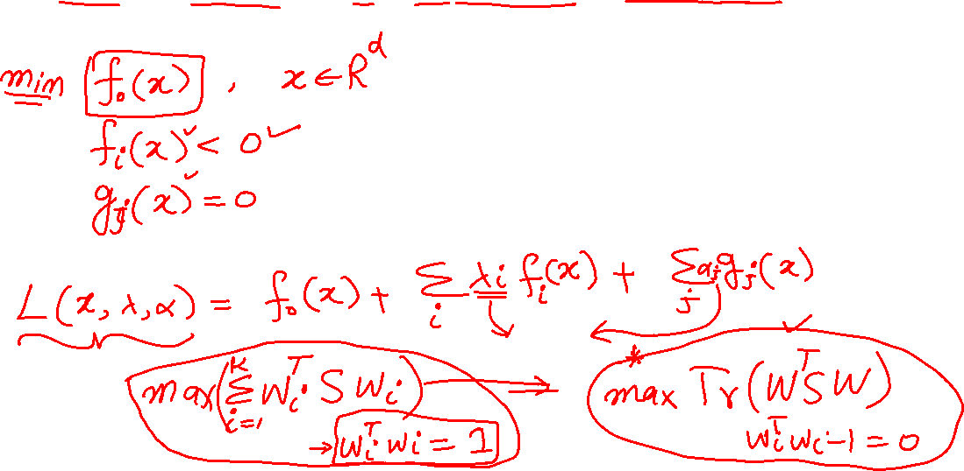
Lagrange Multipliers

Slide 49
Activity - 5
Linear Algebra and Learning from Data by Gilbert Strang, MIT
Dimensionality Reduction by Ali Ghodsi, University of Waterloo

Slide 50
Feature Extraction

Slide 51
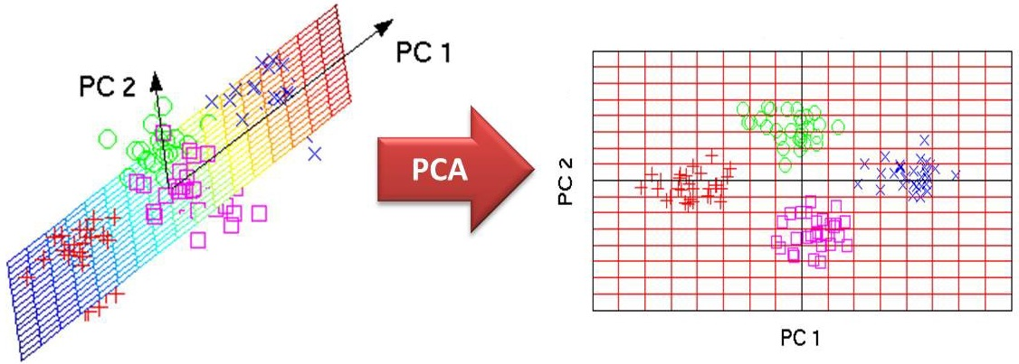
Principal Component Analysis (PCA)

Slide 52
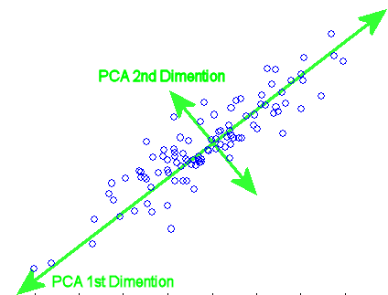
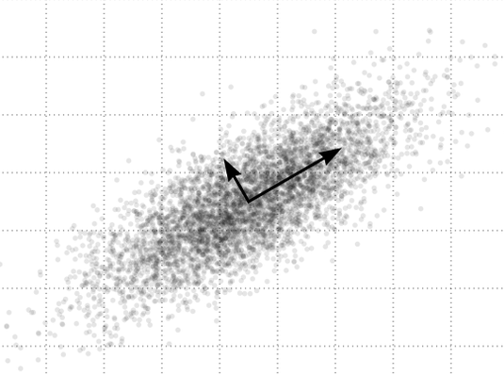
Maximum Variance Preserving Projection

Slide 53
PCA Properties
Linear Transformation

Slide 54
PCA Properties
Linear Transformation
Minimum Reconstruction Error

Slide 55
PCA Properties
Linear Transformation
Minimum Reconstruction Error
Maximum Variance Preservation

Slide 56
PCA Properties
Linear Transformation
Minimum Reconstruction Error
Maximum Variance Preservation
Preserves pairwise Euclidean distances (MDS)

Slide 57



PCA Derivation
$$X_{d,n}$$
$$W_{d,k}$$
$$Y_{k,n}$$

Slide 58
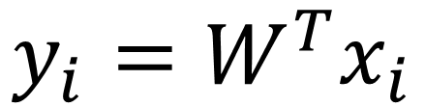
PCA Derivation
$$X_{d,n}$$
$$W_{d,k}$$
$$Y_{k,n}$$
$$y_{i}=W^{T}x_{i}$$

Slide 59

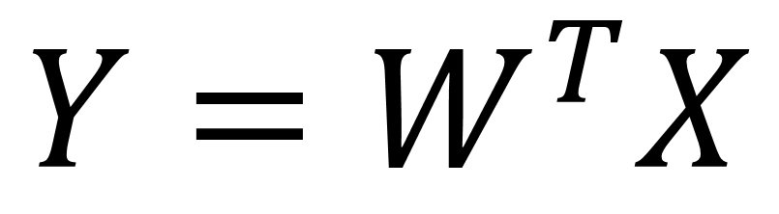
PCA Derivation
$$X_{d,n}$$
$$W_{d,k}$$
$$Y_{k,n}$$
$$y_{i}=W^{T}x_{i}$$
$$Y=W^{T}X$$
$$k≪d$$

Slide 60
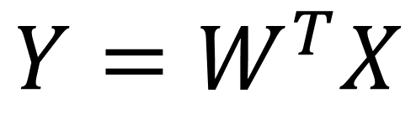
Max Variance
$$Y=W^{T}X$$

Slide 61
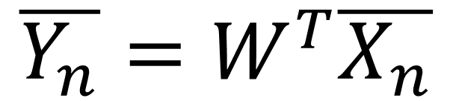
Max Variance
$$Y=W^{T}X$$
$$\overline{Y_{n}}=W^{T}\overline{X_{n}}$$

Slide 62
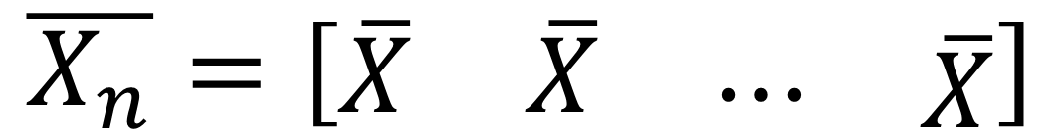
Max Variance
$$Y=W^{T}X$$
$$\overline{Y_{n}}=W^{T}\overline{X_{n}}$$
$$\overline{X_{n}}=\left[\begin{matrix}\overline{X} & \overline{X} & \begin{matrix}⋯ & \overline{X}\end{matrix}\end{matrix}\right]$$

Slide 63
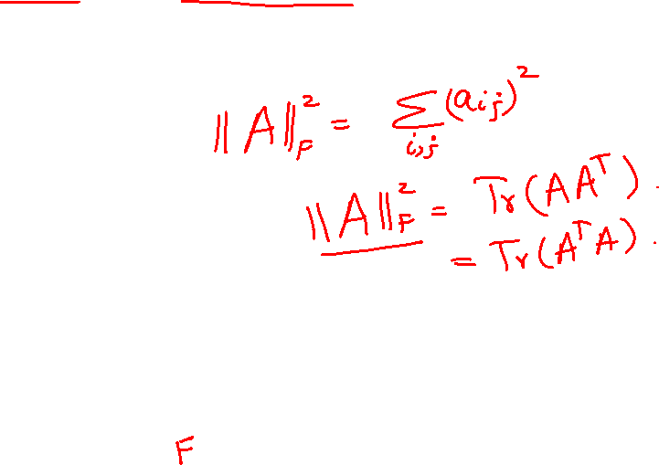
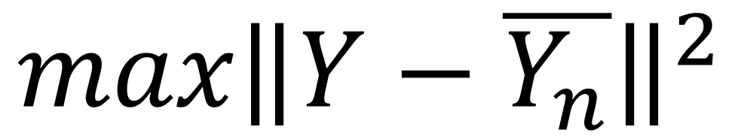
Max Variance
$$Y=W^{T}X$$
$$\overline{Y_{n}}=W^{T}\overline{X_{n}}$$
$$\overline{X_{n}}=\left[\begin{matrix}\overline{X} & \overline{X} & \begin{matrix}⋯ & \overline{X}\end{matrix}\end{matrix}\right]$$
$$max{\left\|Y−\overline{Y_{n}}\right\|}^{2}$$

Slide 64
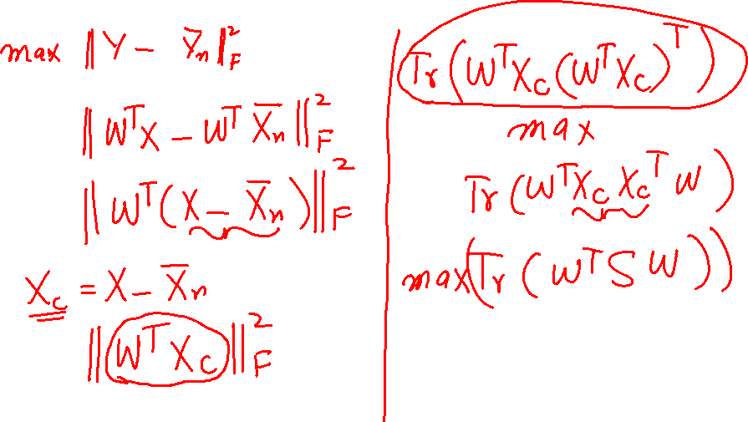
Max Variance

Slide 65
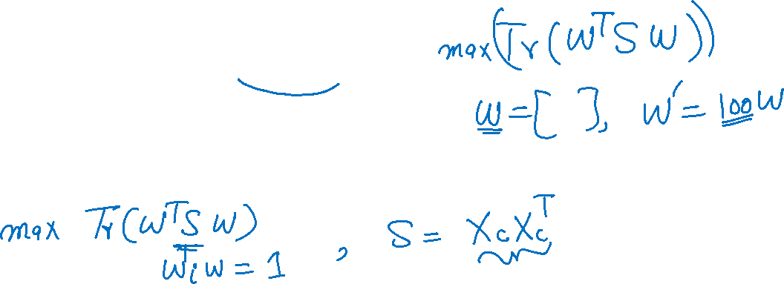
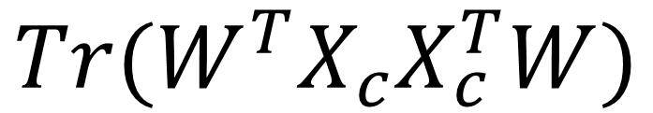
Max Variance
$${Tr(W}^{T}X_{c}X_{c}^{T}W)$$
Eigen Decomposition of the covariance matrix

Slide 66
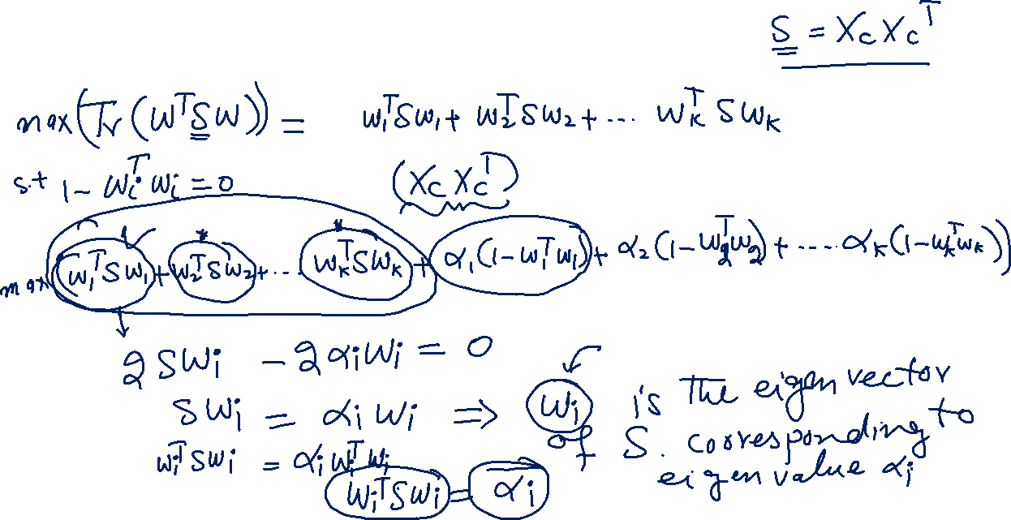
PCA Solution

Slide 67
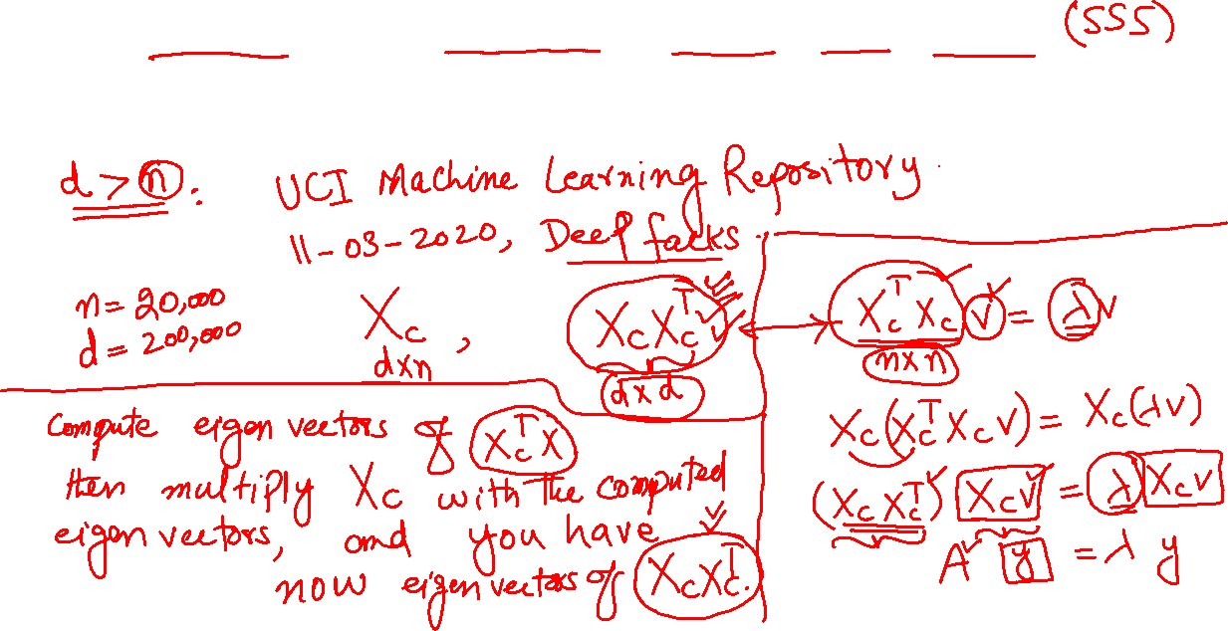
PCA for Small Sample Size Problem

Slide 68
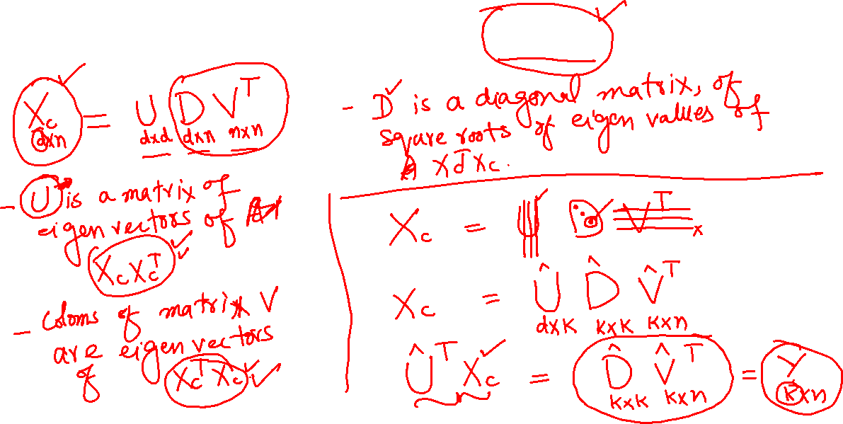
PCA Using SVD

Slide 69
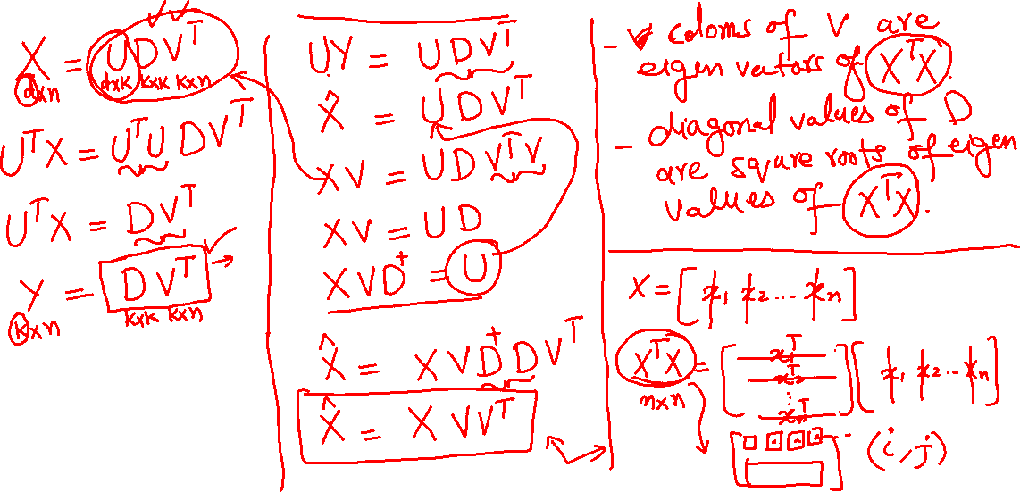
Kernel PCA

Slide 70
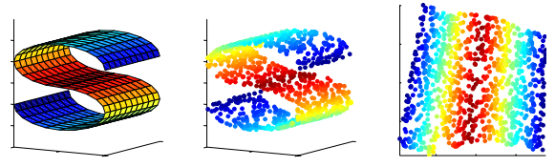
Kernel PCA

Slide 71
MDS
ISOMAP
LLE
LEM
MVU

Slide 72
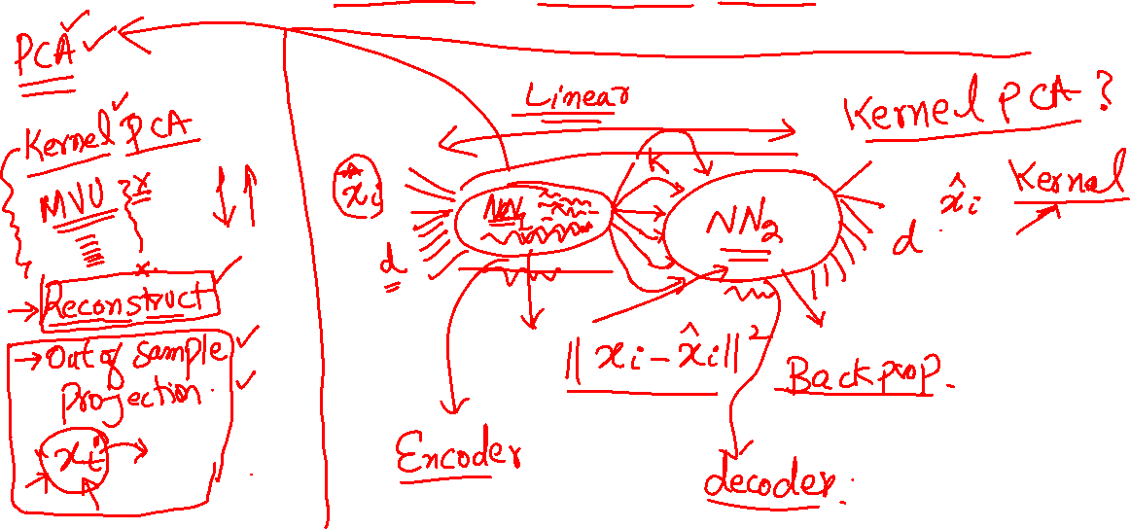
Auto Encoders

Slide 73
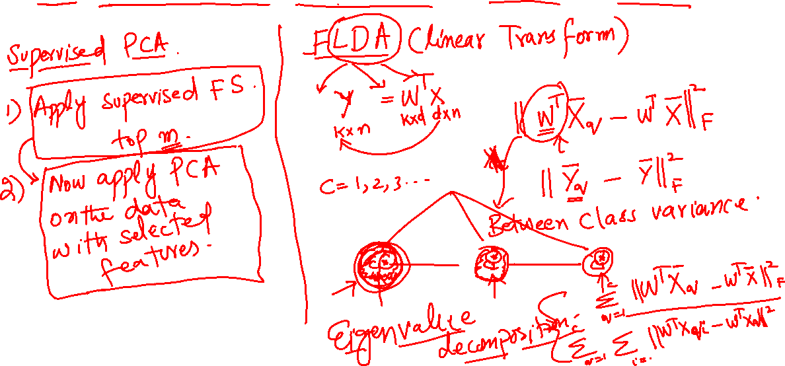
Supervised Feature Extraction

Slide 74
Activity - 6
Implement Fisher’s Linear Discriminant analysis using sklearn

Slide 75
Feature Engineering
Categorical Features

Slide 76
Feature Engineering
Categorical Features
Text Features

Slide 77
Feature Engineering
Categorical Features
Text Features
Image Features

Slide 78
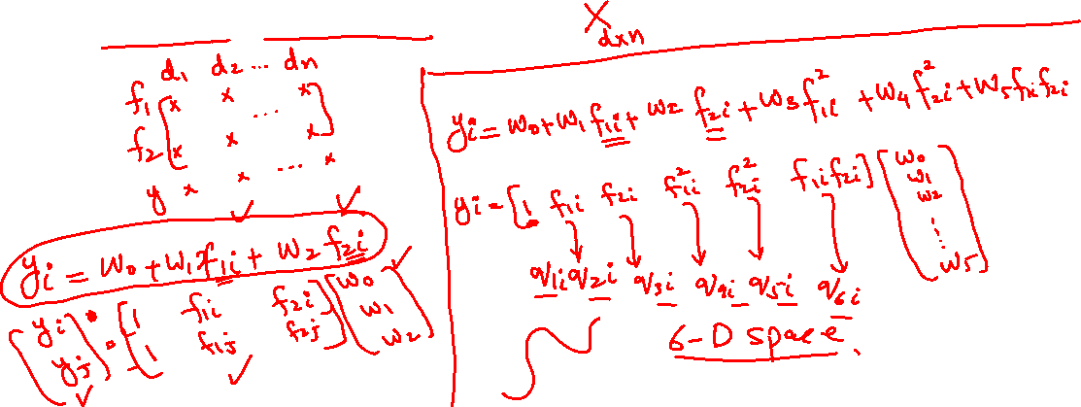
Feature Engineering
Derived Features

Slide 79
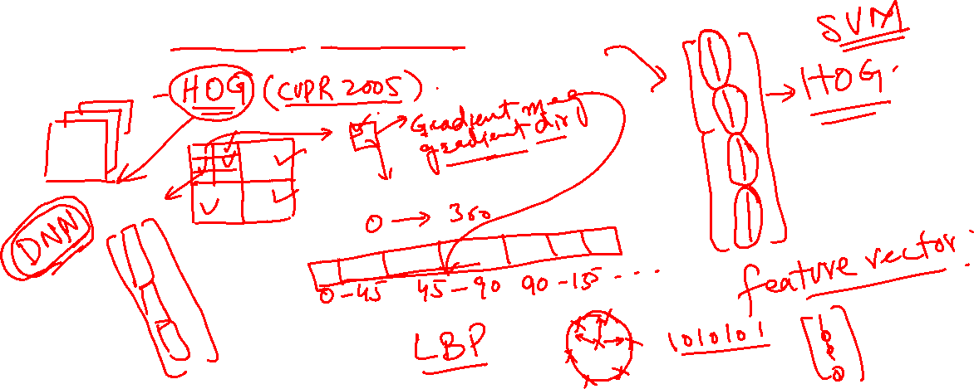
Feature Engineering
Derived Features Images

Slide 80
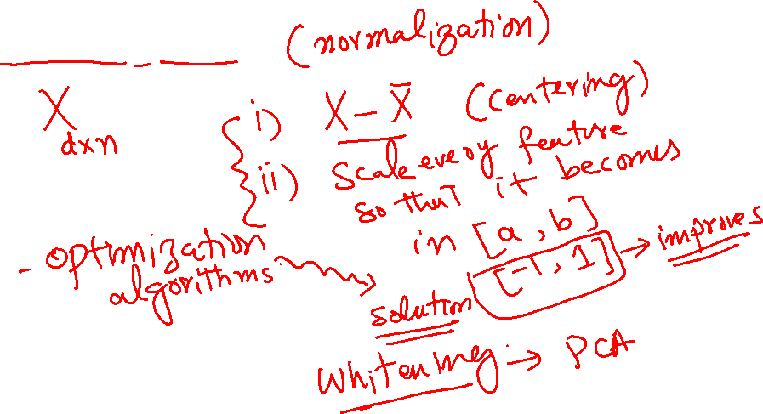
Feature Engineering
Feature Scaling

Slide 81
Activity - 7
Dimensionality Reduction in Big Data?

